Slide 1

SESSION 1
How to Write Cold Emails…
(and actually get replies!)
By Shaan Puri
POWER WRITING COURSE

Slide 2
Cold emails are a weapon to use when…
You’re looking for a job… cold email hiring managers
You want to meet someone you admire… cold email them
You start a brand… cold email influencers to rep your brand
You start a company… cold email investors
3/36 SHAANPURI.COM POWER WRITING COURSE
Notes:
^Pause for a second.
Look at those outcomes (getting your dream job, making a sale, raising $$ from investors)
If you learn just this one lesson and forget everything else, your investment in this course will be paid back, bigtime.

Slide 3
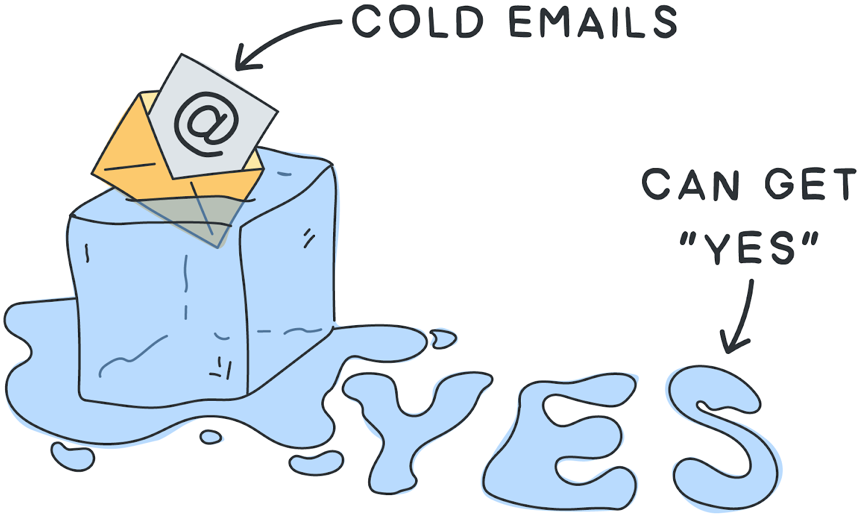
2/36 SHAANPURI.COM POWER WRITING COURSE
At the end of this session, your cold emails should get that YES

Slide 4
PICK A SCENARIO THAT FITS YOU… AND TRY IT!
Cold email a potential customer to buy your product
Cold email the ceo of the company you’d love to work for
Cold email someone you look up to, with the goal of getting some advice
Cold email an instagram influencer to work with your company
Cold email an investor to invest in your business
Cold email a company to get them to sponsor your content
5/36 SHAANPURI.COM POWER WRITING COURSE
If you’re stumped, imagine you’ve built an app that helps personal trainers send workouts to their clients. Send a cold email to get a personal trainer to try your app!

Slide 5
You have 10 minutes.
Don’t overthink it, just write!
(it’s OK if it sucks, we will make it better later! No more than 10 mins!)
6/36 SHAANPURI.COM POWER WRITING COURSE

Slide 6
Let’s Try It!
Open A Google Doc & Draft A Cold Email
7/36 SHAANPURI.COM POWER WRITING COURSE

Slide 7
8/36 SHAANPURI.COM POWER WRITING COURSE
I Need A Brave Volunteer

Slide 8
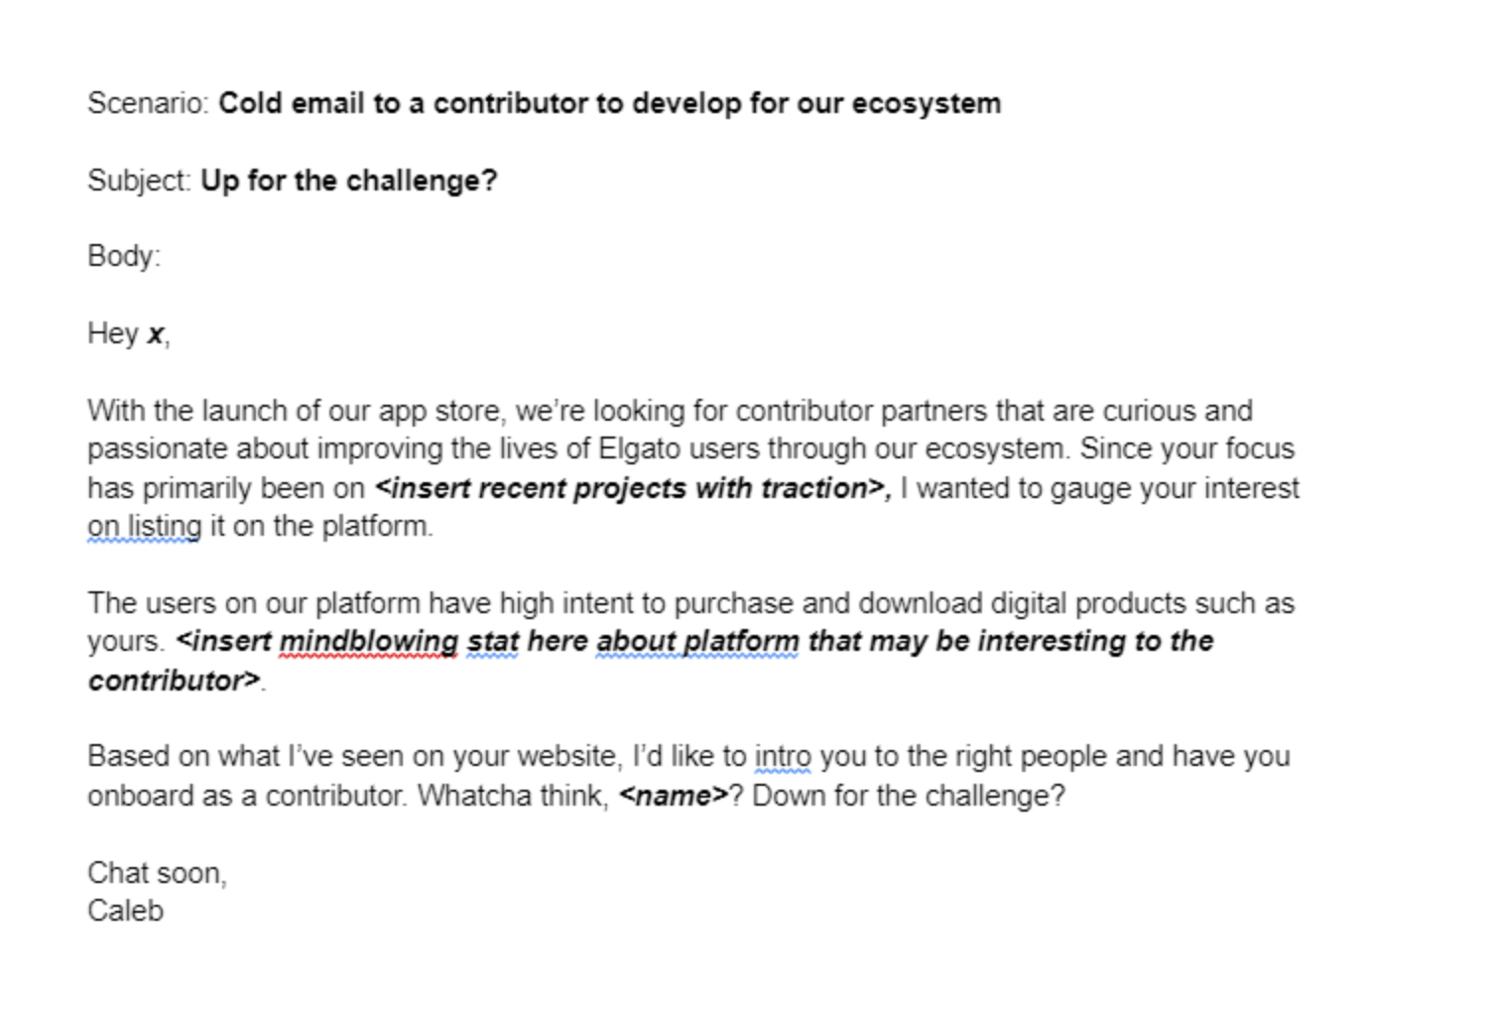
9/36 SHAANPURI.COM POWER WRITING COURSE
Volunteer
The Original:
Live Re-Write:
Hey X, big fan of ______. Really cool the way you blah blah blha
I’m reaching out, because I think I can help you reach ~2k-5k more customers. I’ll explain in a second.
About me - I run elgato partnerships and work with ______, _____, & ____.
Long story short, if you were to do X , you could get Y. If you’re interested, just say “interested” & we can do X

Slide 9
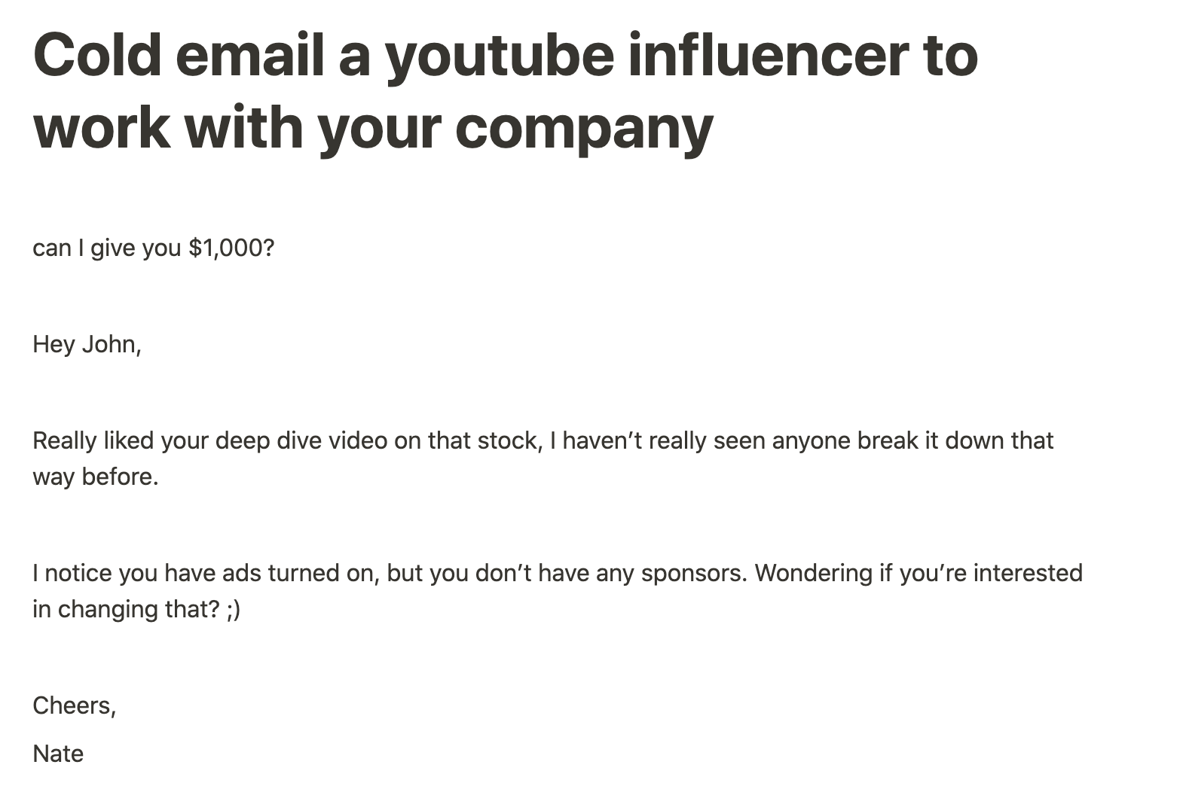
9/36 SHAANPURI.COM POWER WRITING COURSE
Live Re-Write:
Volunteer
The Original:
What’s in it for them ✅
Doesn’t sound like spam. Talk like a human ✅
I’m VP of partnerships for wall street zen.
We just launched, but get about 1M visitors a month, and are about to
Start partnering with awesome youtubers this month. I’m personally a fan
Of you. So I put you at the top of my list for people to reach out to.

Slide 10
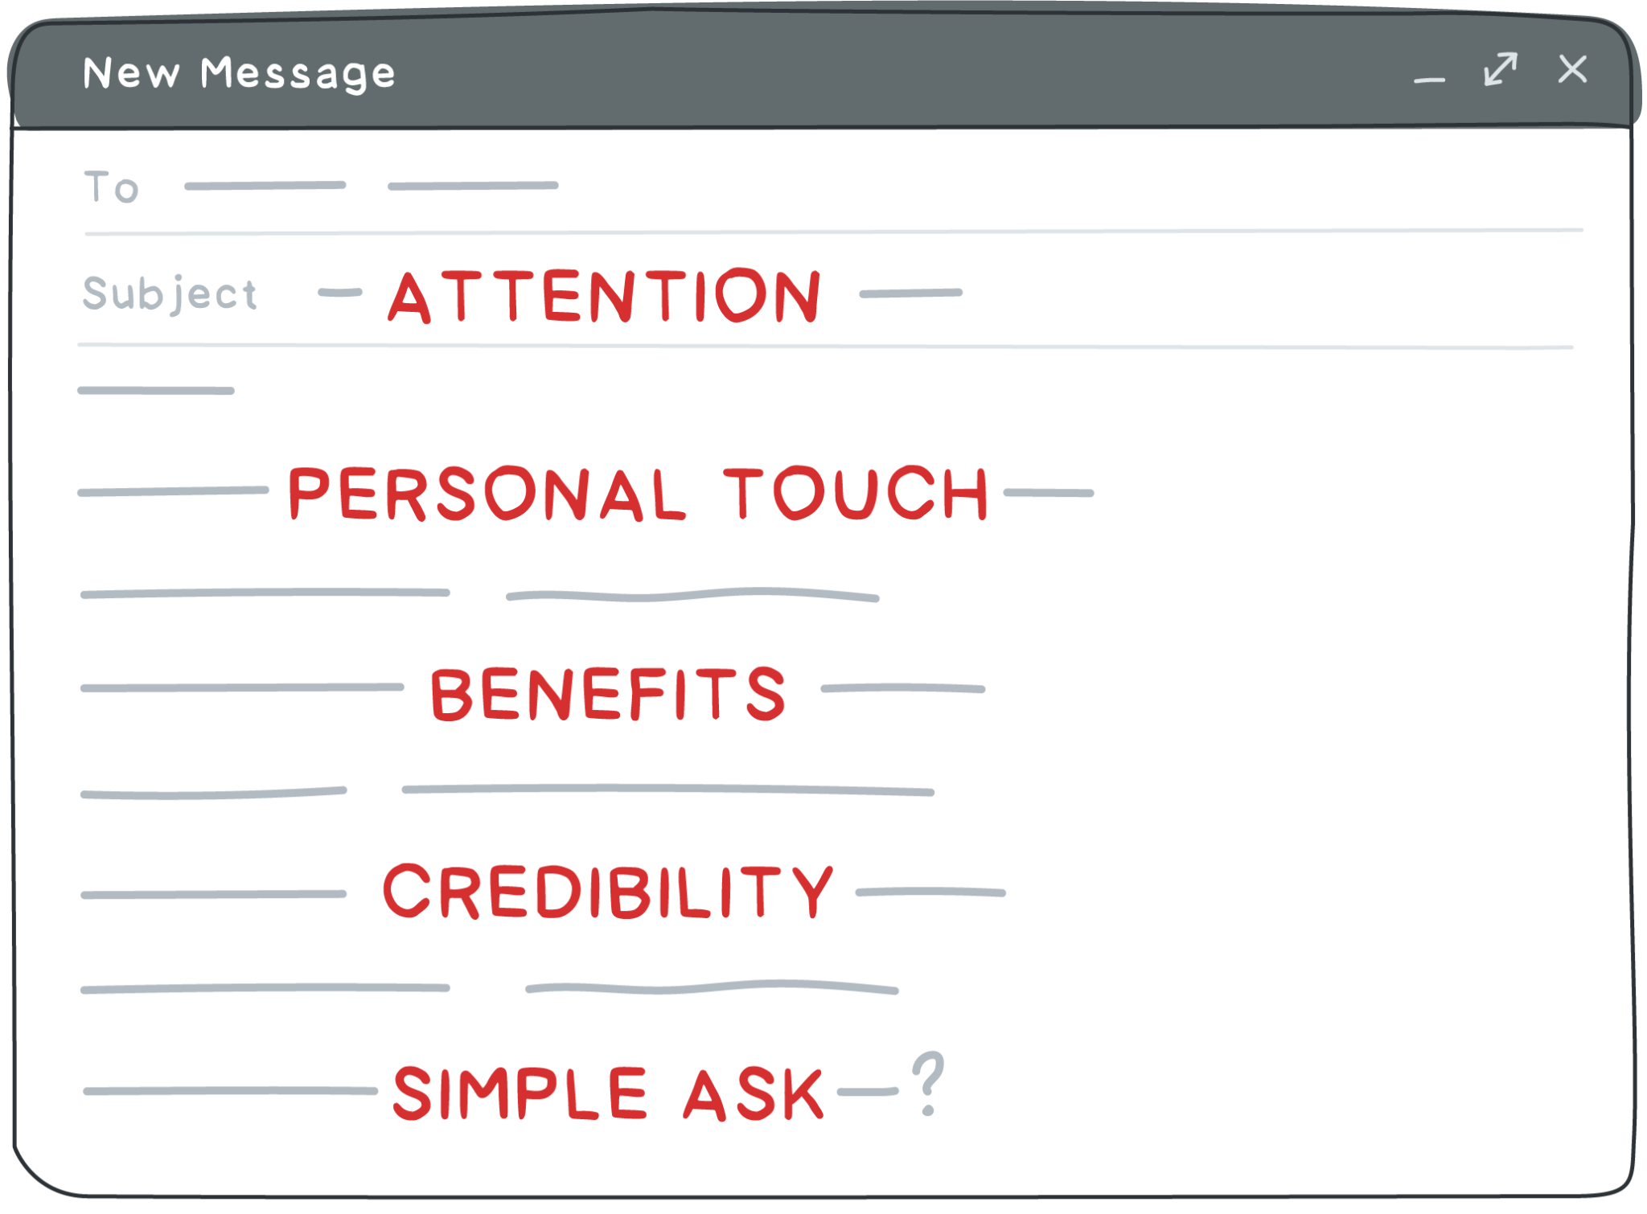
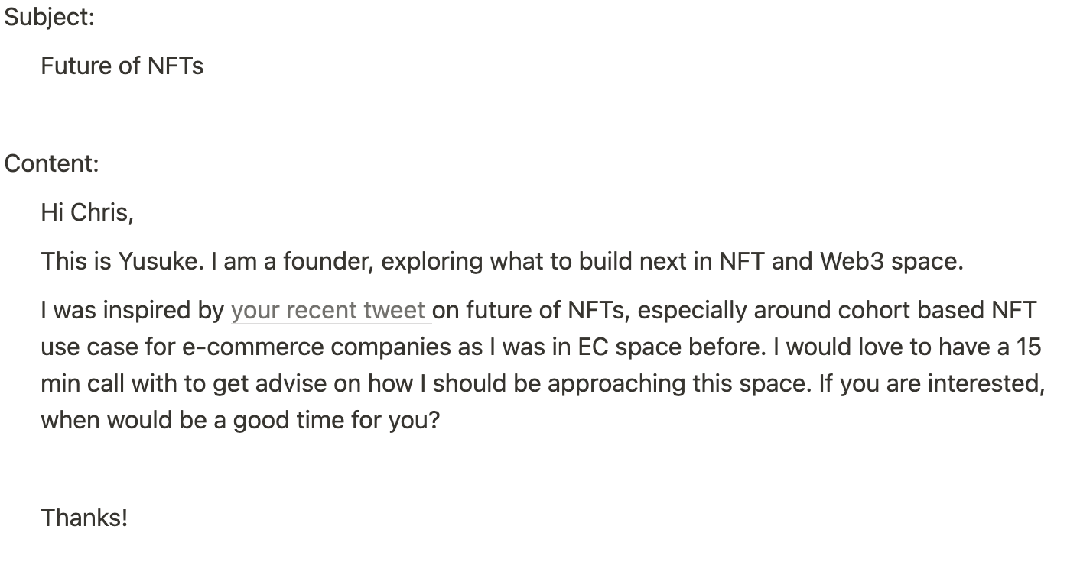
9/36 SHAANPURI.COM POWER WRITING COURSE
Live Re-Write:
Volunteer
The Original:
Chris, loved your tweet about the future of NFTs in ecom. Funny story, I used to sell japanese hot springs blah blah to americans via ecom - so everything you said, resonated with me.
I’m reaching out because I’m plotting my next move - and am very interested in launching an cohort NFT… but - I haven’t seen any examples that have inspired me yet. Do you know of any?

Slide 11
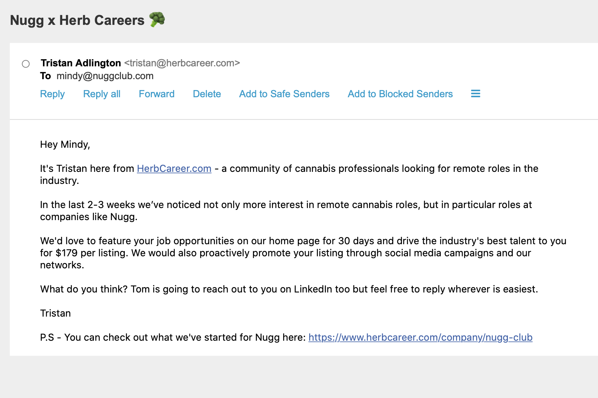
9/36 SHAANPURI.COM POWER WRITING COURSE
Live Re-Write:
The Original:
Volunteer
Love nuggs. My girlfriend thinks I’m nuts because I smoke them twice a week.
I’m reaching out because I think I can get your job postings in front of at least 10,000 people.
The best part is, these are people super into X and not just linkedin drones.
I’d love to post one of your key listings there for a couple days so you can see what kind of inbound you get. Would you be down? Just say the word and I’ll make it happen

Slide 12
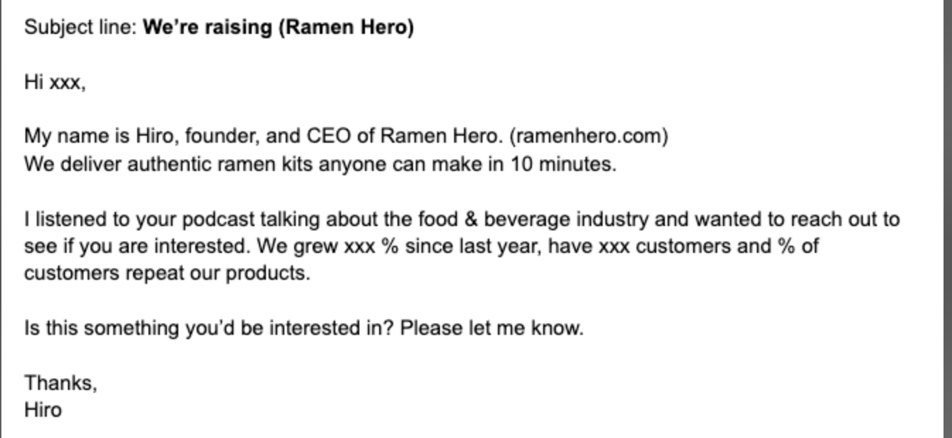
9/36 SHAANPURI.COM POWER WRITING COURSE
Live Re-Write:
The Original:
Volunteer

Slide 13
What tools & techniques do I use in the re-write?
13/36 SHAANPURI.COM POWER WRITING COURSE

Slide 14
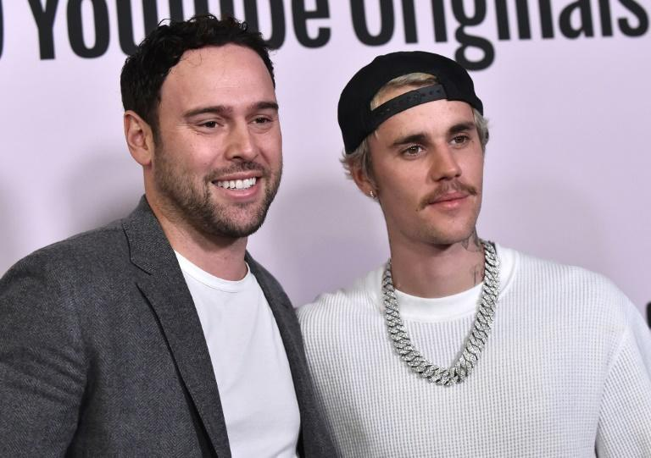
12/36 SHAANPURI.COM POWER WRITING COURSE
The Scooter Braun Law
Yes, No, or “cool, Marie will schedule”

Slide 15
14/36 SHAANPURI.COM POWER WRITING COURSE
Here’s the formula I use… it’s a variation of AIDA

Slide 16

15/36 SHAANPURI.COM POWER WRITING COURSE
Attention
The goal with the subject line is to create a curiosity gap.

Slide 17
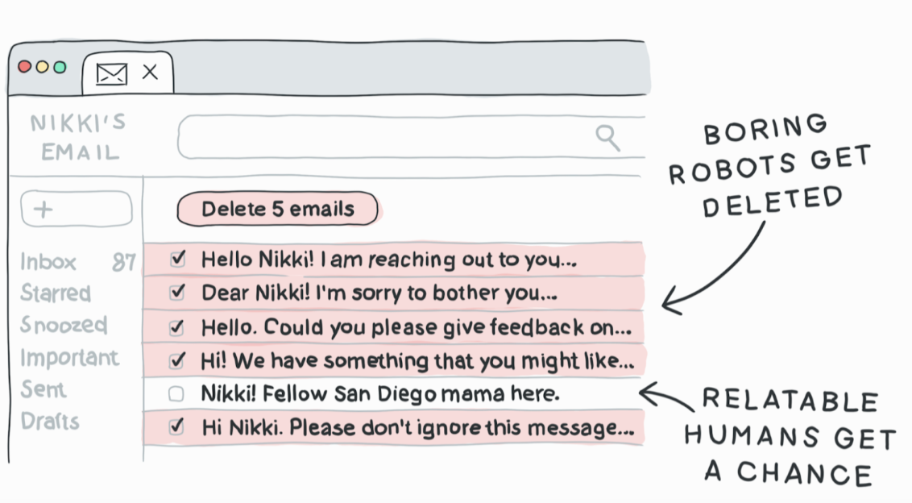
16/36 SHAANPURI.COM POWER WRITING COURSE
Personal Touch
98% of email is mass spam. Show that this isn’t mass spam.

Slide 18
17/36 SHAANPURI.COM POWER WRITING COURSE
Offer and Benefits
Be a giver, instead of asker.
Wanna send you a free sample, what’s your address?
I looked at your onboarding, here’s 3 improvements
I think I could boost your revenue X% by doing y

Slide 19
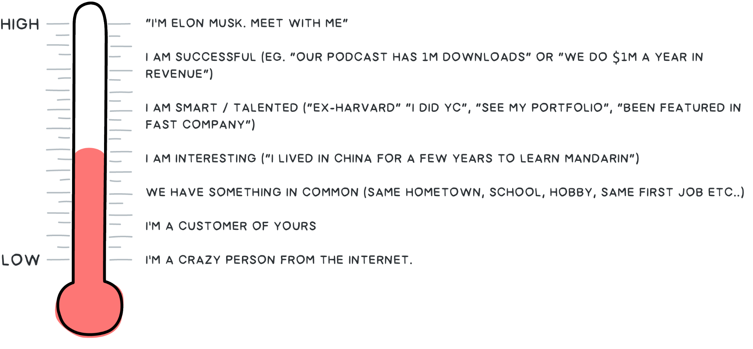
18/36 SHAANPURI.COM POWER WRITING COURSE
Credibility
Your goal is to not be on the bottom rung.

Slide 20
Time To Put in Action!
19/36 SHAANPURI.COM POWER WRITING COURSE

Slide 21
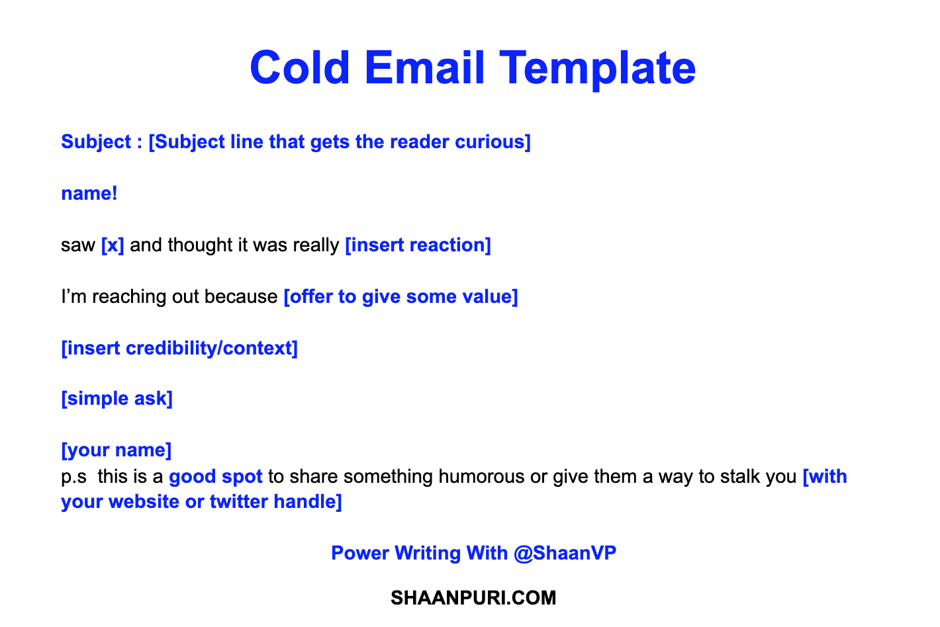
Rewrite Your Cold Email
20/36 SHAANPURI.COM POWER WRITING COURSE

Slide 22
14/36 SHAANPURI.COM POWER WRITING COURSE
Here’s the formula I use… it’s a variation of AIDA

Slide 23
2/36 SHAANPURI.COM MAVEN
Oh no they didn’t reply..
…no problem. 80% of the magic is in the follow-up.

Slide 24
2/36 SHAANPURI.COM MAVEN
Your goal with the follow up
Don’t cry/nag
Simply bump, with value
You want to be politely persistent

Slide 25
2/36 SHAANPURI.COM MAVEN
Examples of quick follow ups:
“Wanted to give this a bump. You guys are my top choice, so you can’t blame me for swinging for the fences, can you?
“Did you have any interest in doing this? Since that first email - we’ve had a ton of progress. X Y & Z have come on board. Would love to have you on before we wrap up the schedule”
“Did you have a chance to look at this? Slide 3 is the main thing that should get your attention”

Slide 26
2/36 SHAANPURI.COM MAVEN
Following up should 2x the total reply rate.
Set auto-followups for 1 day later, 3 days later, and 5 days later.

Slide 27
Summary
The goal is to get a 1 word or 1 sentence reply (“yes/okay/I’m interested)
Be a giver, not a beggar (aka - what’s in it for them)
Keep it short. The Longer it is, the crazier/more desperate you seem
The goal is to go from cold → warm
80% of the magic is in the follow up
22/36 SHAANPURI.COM POWER WRITING COURSE

Slide 28
APPENDIX
2/36 SHAANPURI.COM MAVEN

Slide 29

This works!
2/36 SHAANPURI.COM MAVEN
A few examples

Slide 30
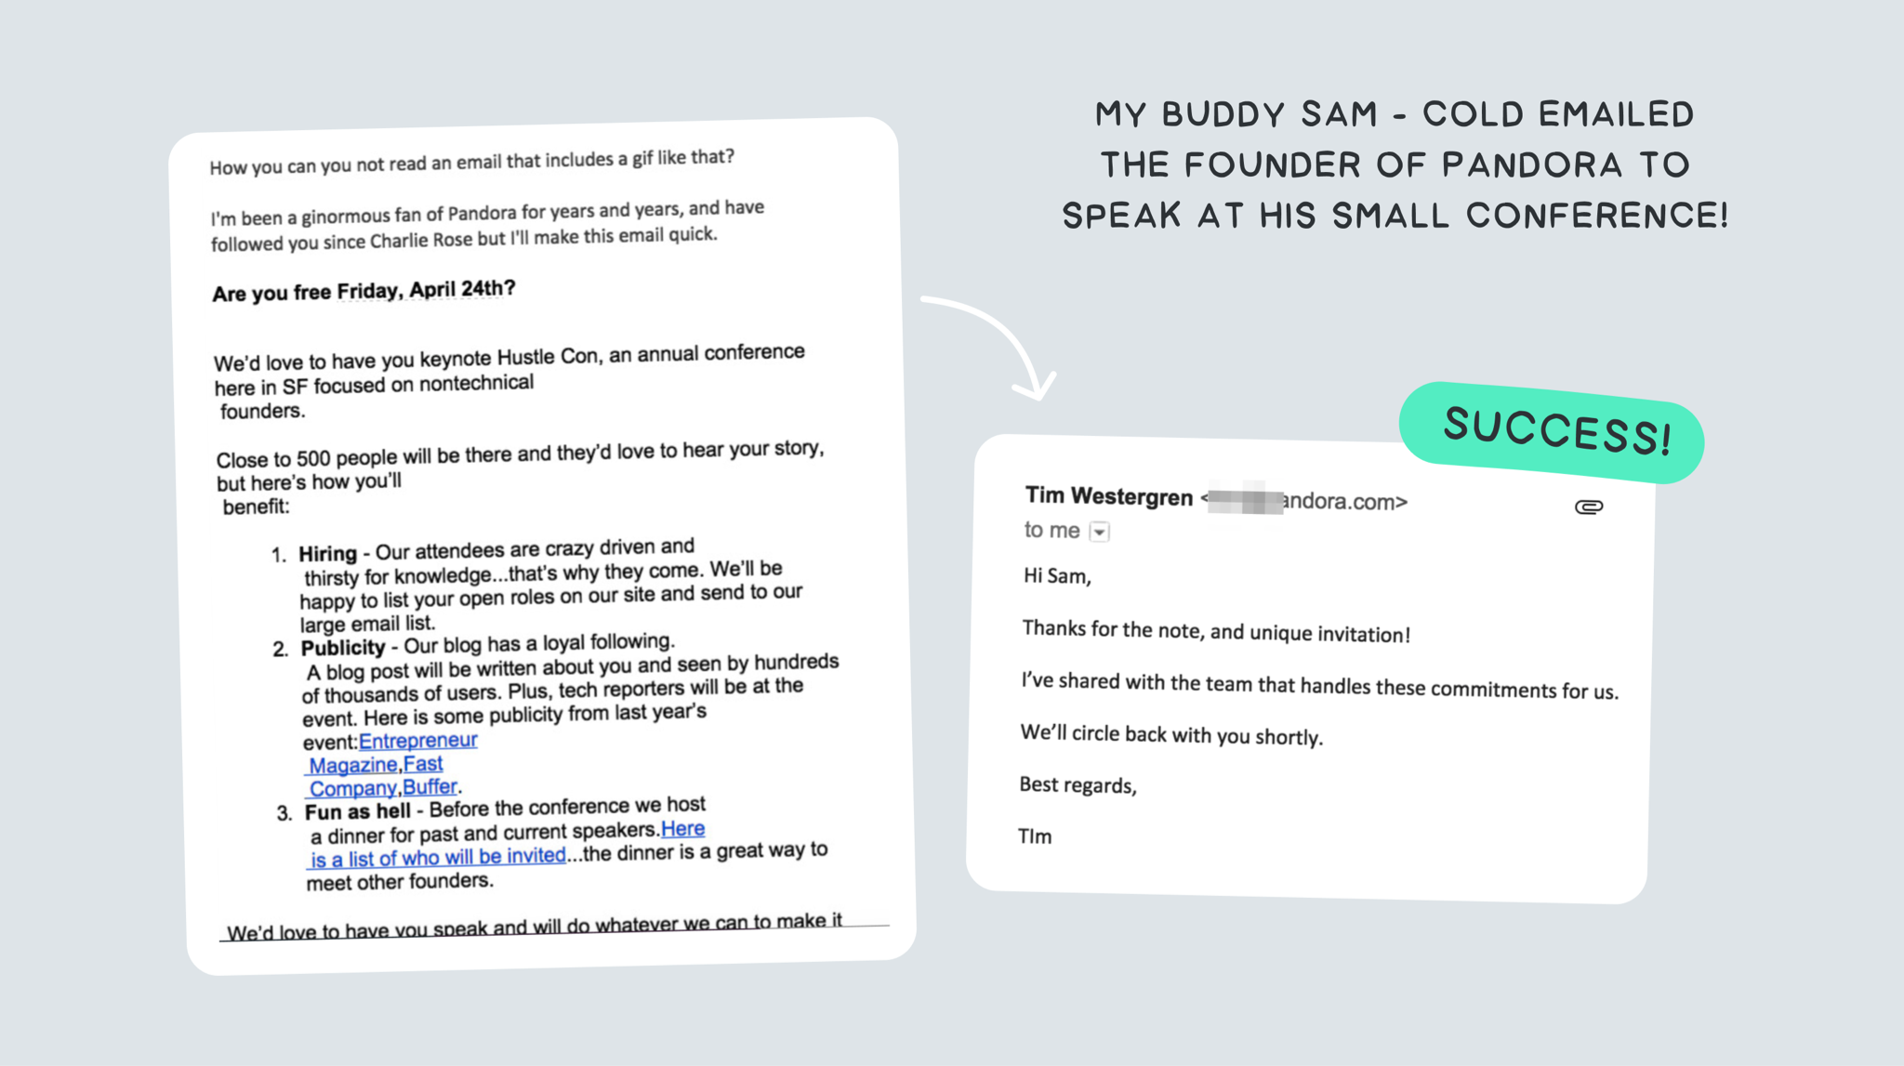
2/36 SHAANPURI.COM MAVEN

Slide 31
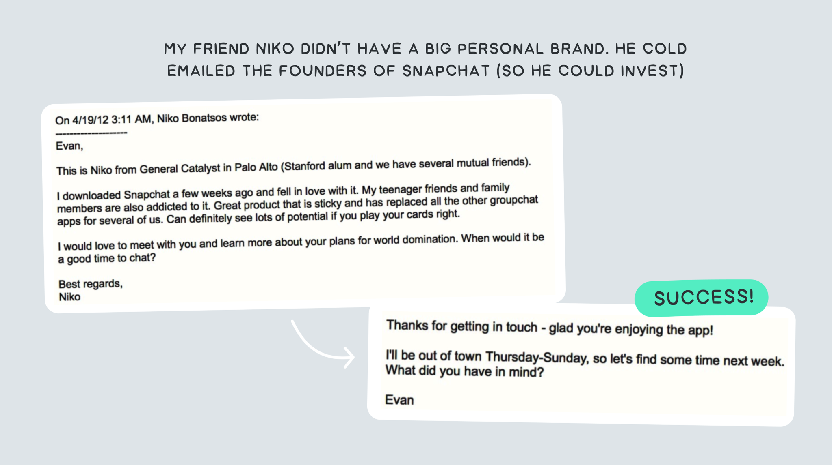
2/36 SHAANPURI.COM MAVEN

Slide 32
OK!
Here’s some great cold emails I’ve received.
2/36 SHAANPURI.COM MAVEN

Slide 33
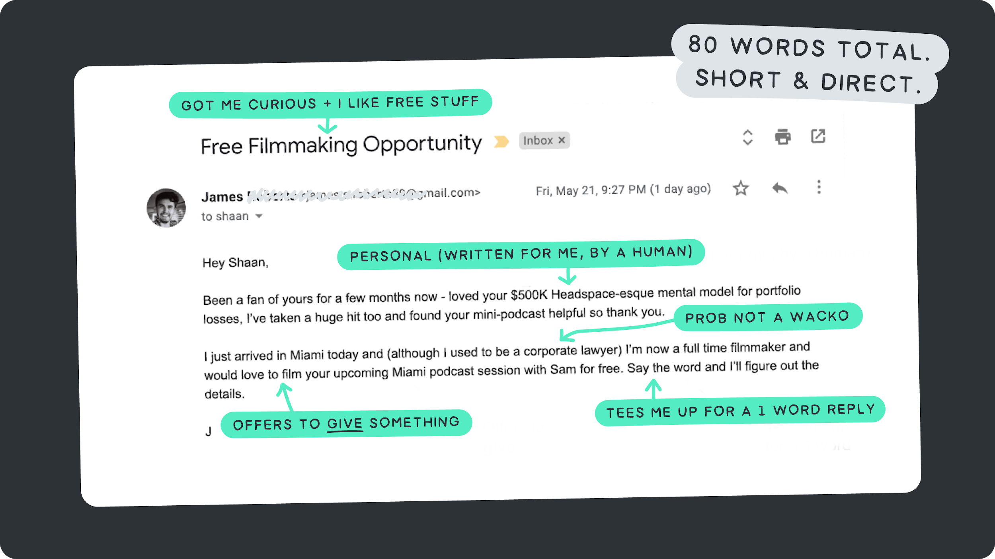
2/36 SHAANPURI.COM MAVEN

Slide 34
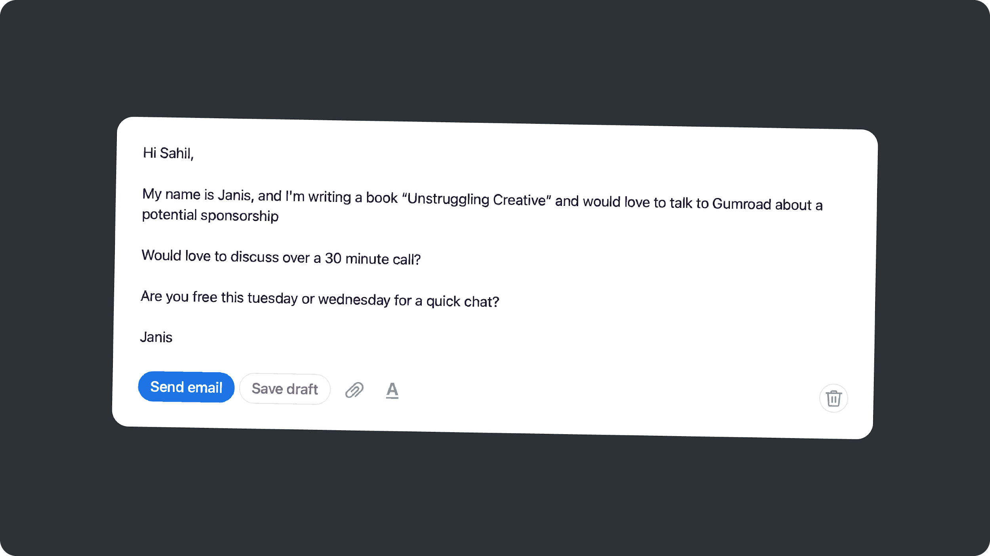
2/36 SHAANPURI.COM MAVEN
Scenario: Cold emailing a potential sponsor (mediocre email)

Slide 35
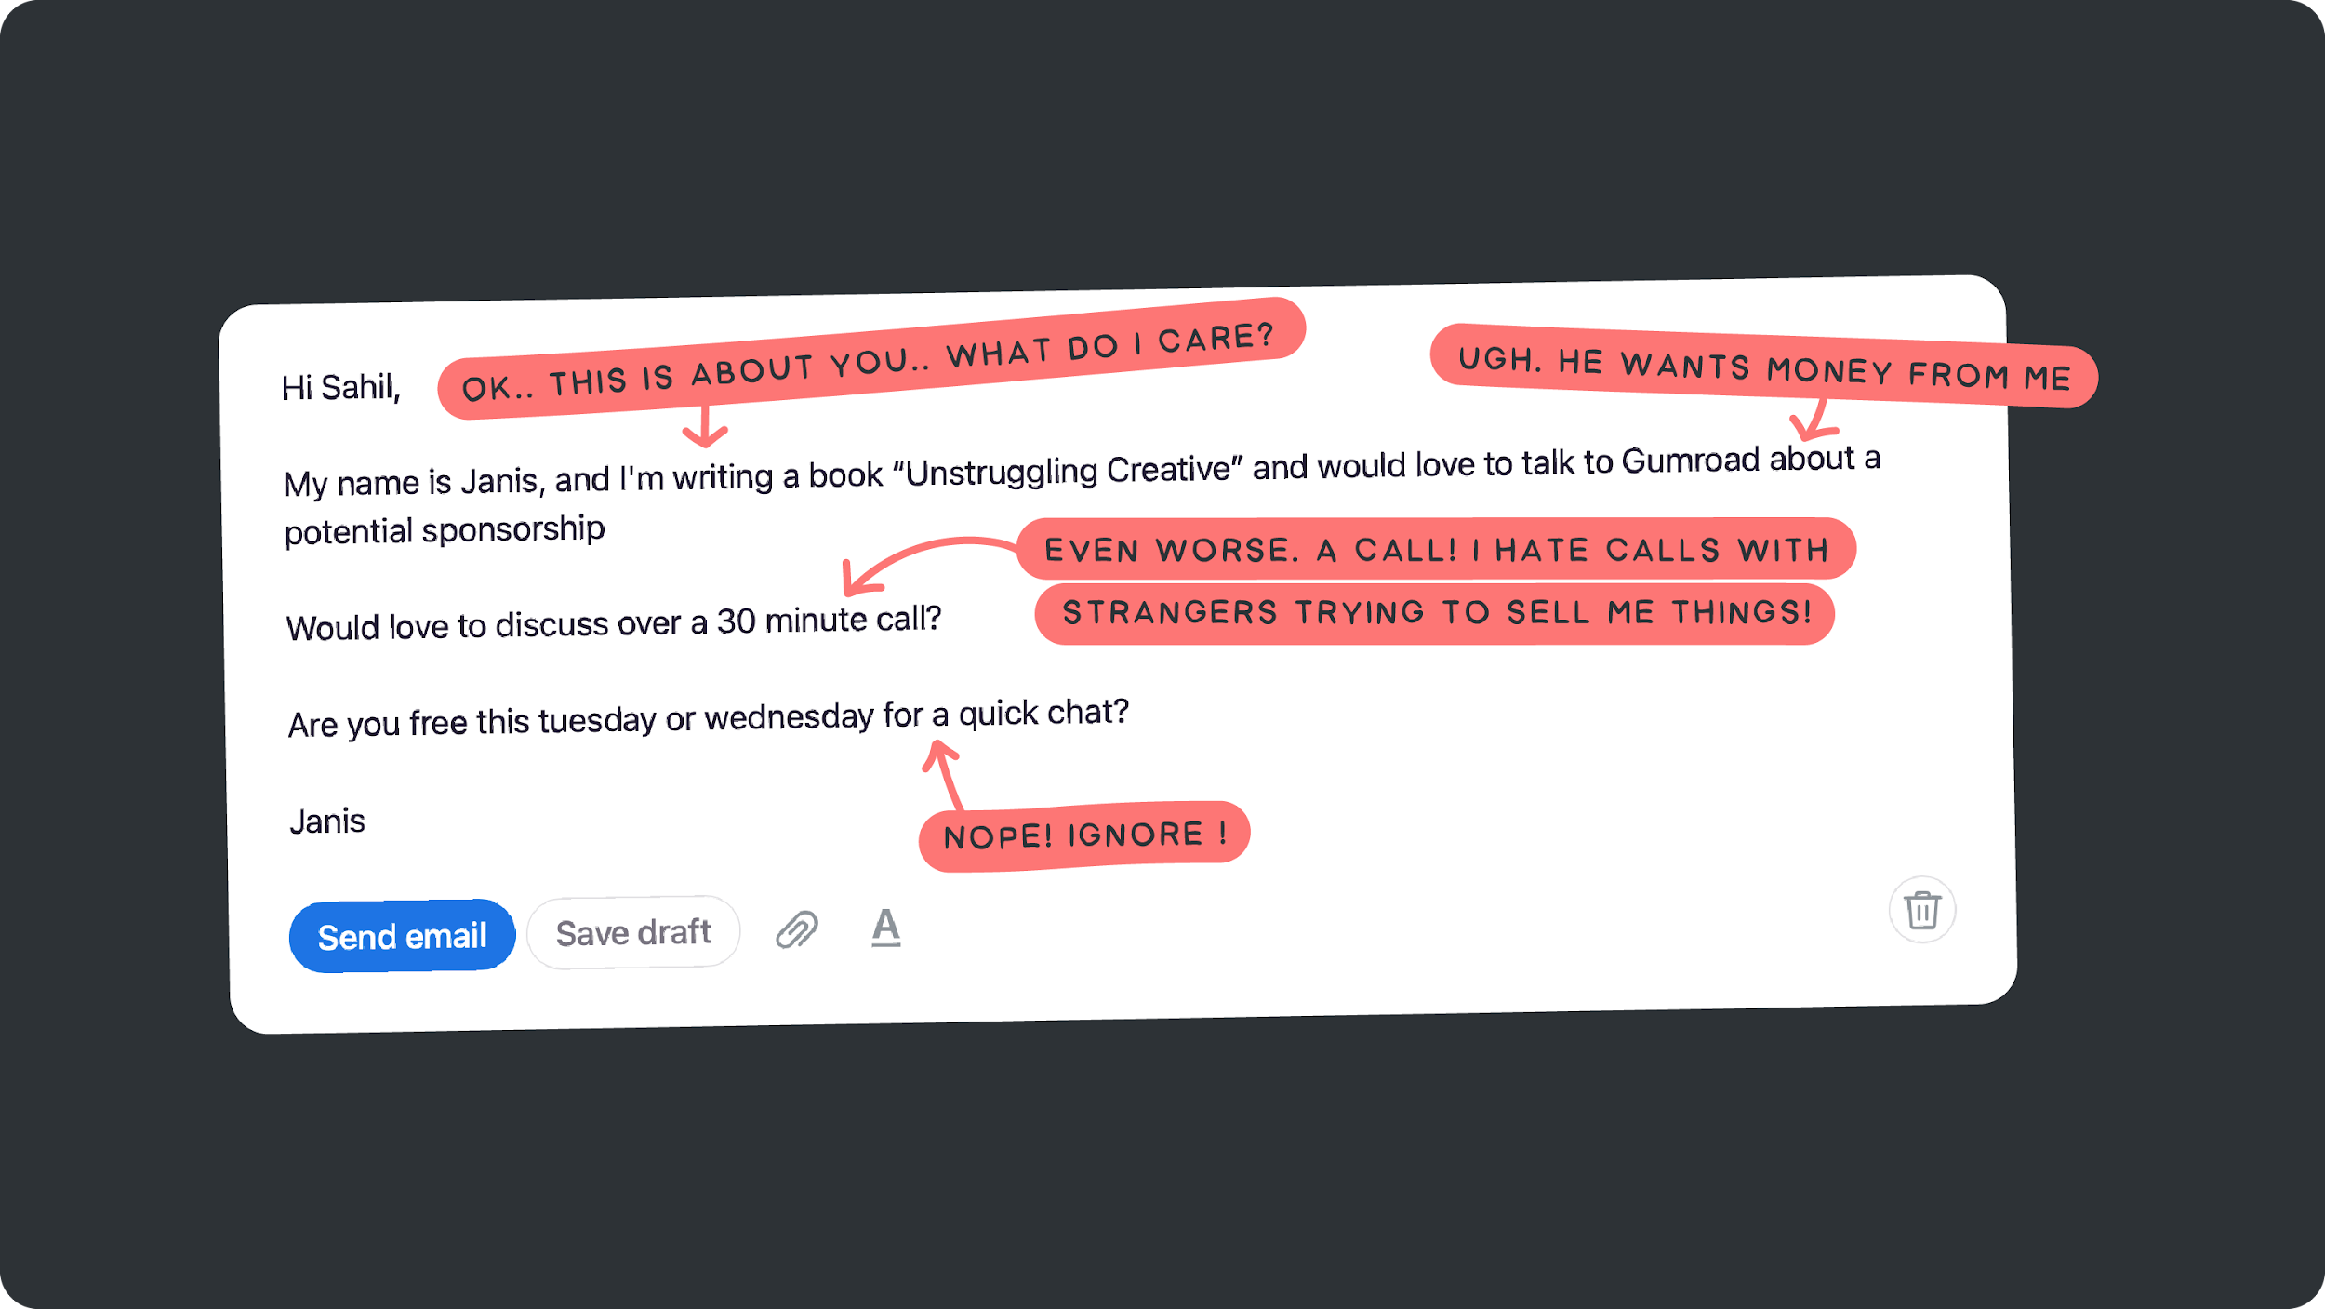
2/36 SHAANPURI.COM MAVEN
Scenario: Cold emailing a potential sponsor (why it’s bad)

Slide 36
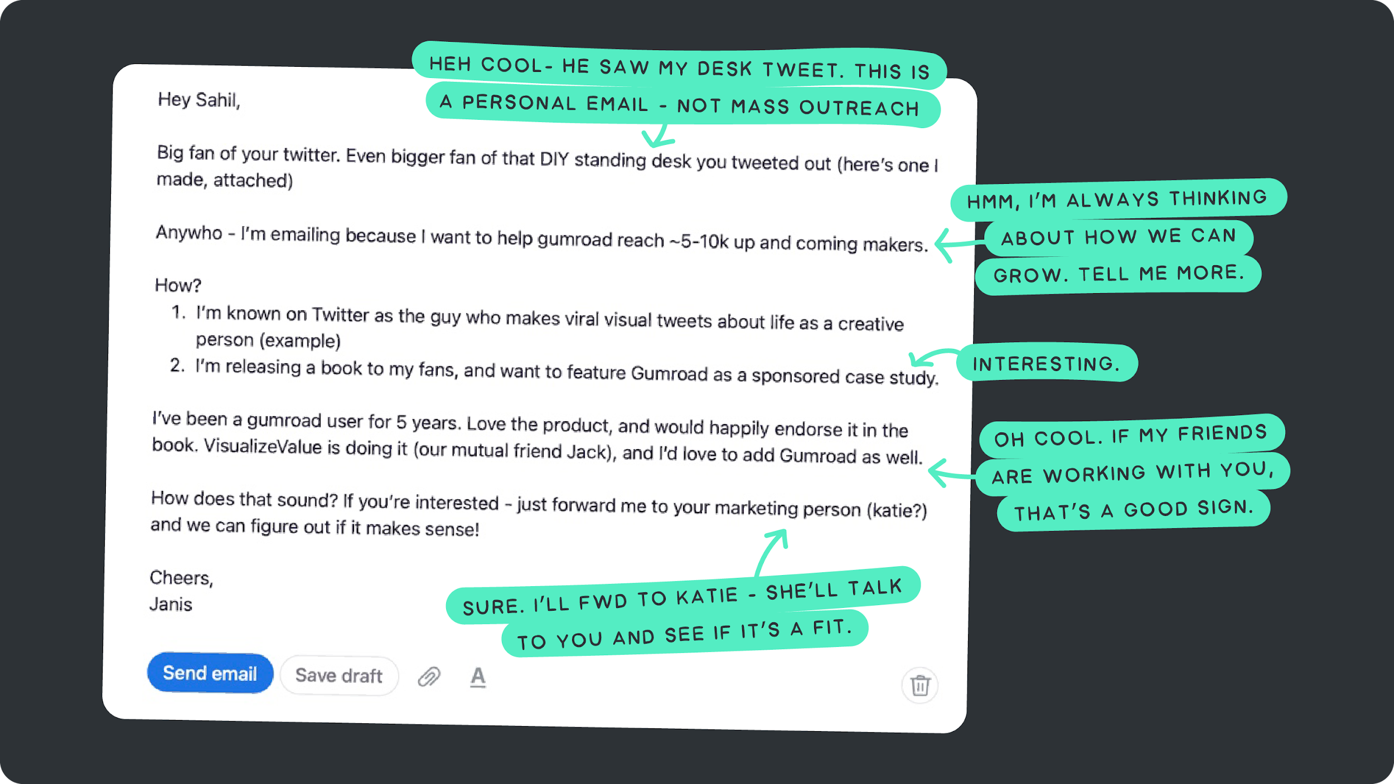
2/36 SHAANPURI.COM MAVEN
*cracks knuckles* How it’s done

Slide 37
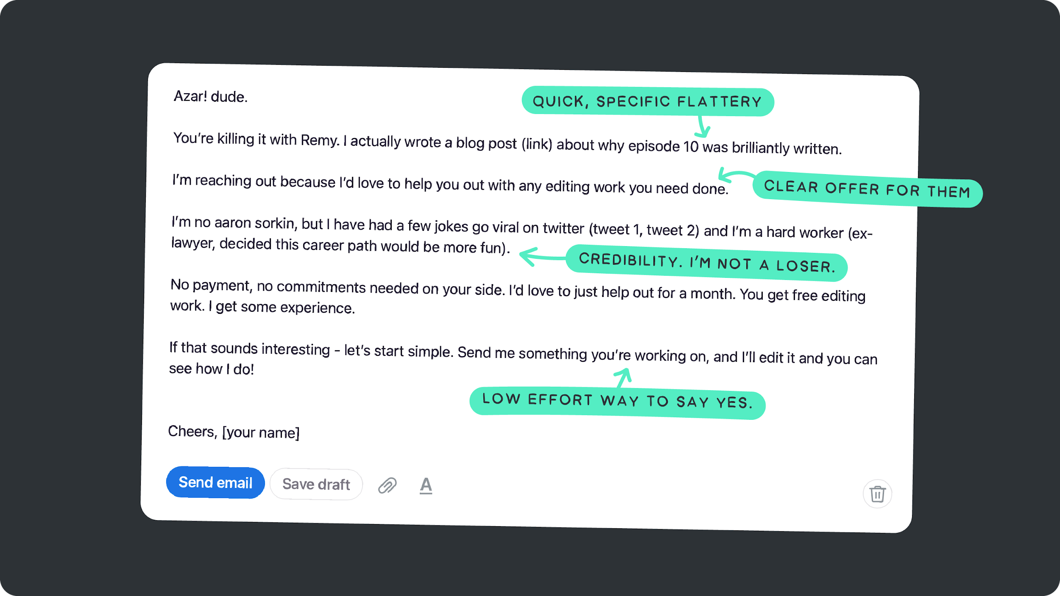
2/36 SHAANPURI.COM MAVEN
Example #2: My friends brother wants to be a writer for TV shows. Here’s a cold email he sent to Azar, the writer of a Hulu show Remy.

Slide 38
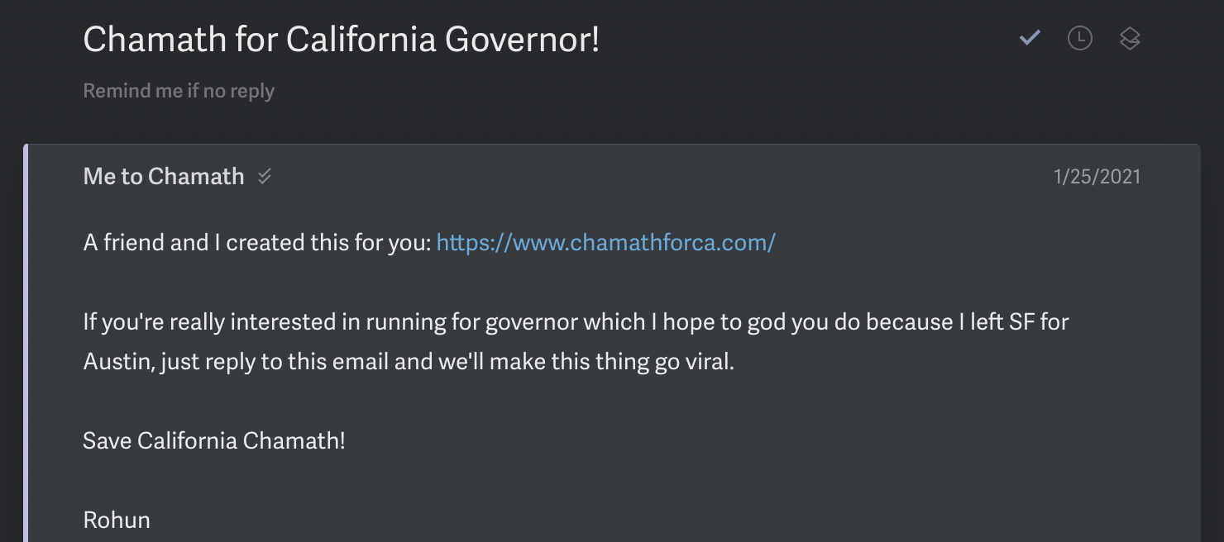

Slide 39
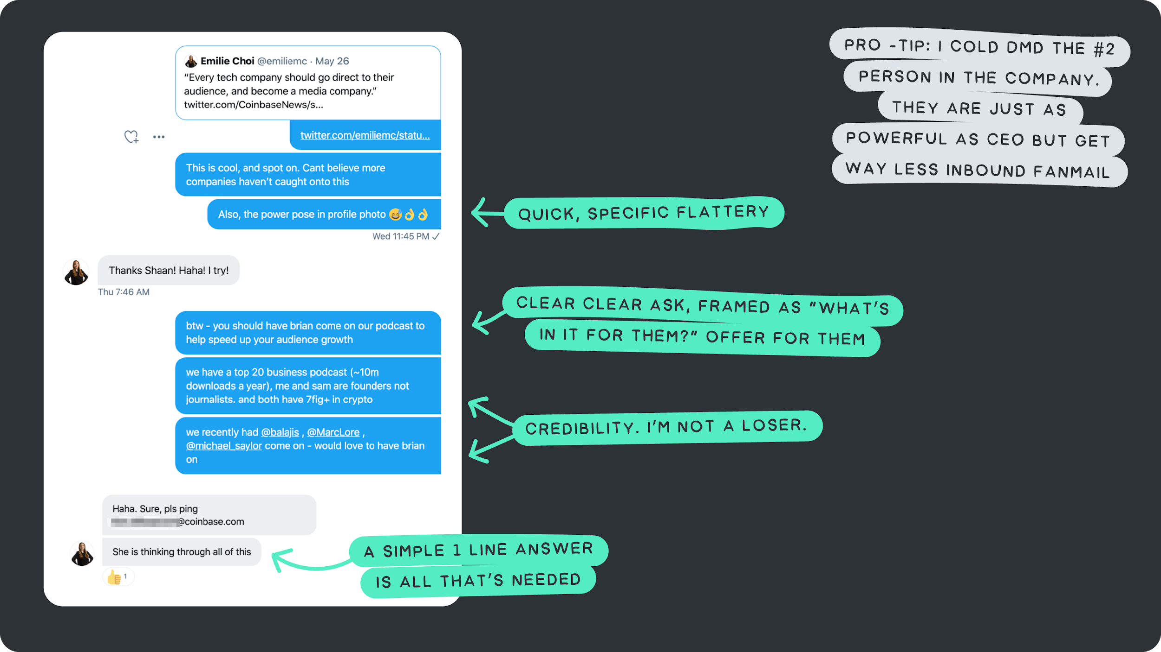
2/36 SHAANPURI.COM MAVEN
Example #3: How I landed the CEO of Coinbase on my podcast

Slide 40
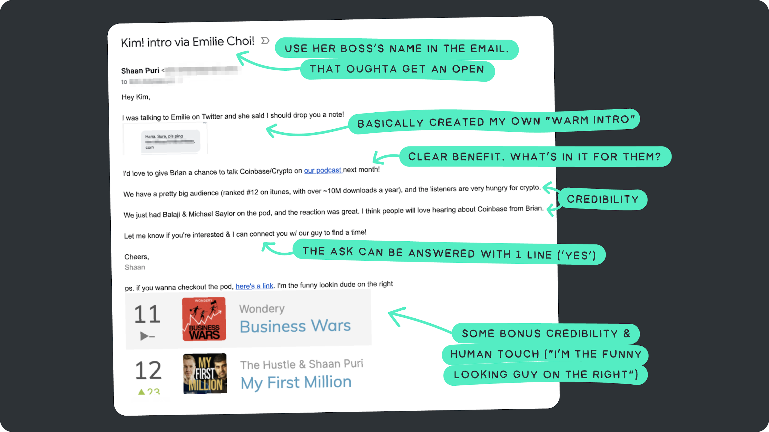
2/36 SHAANPURI.COM MAVEN
Example #3: How I landed the CEO of Coinbase on my podcast

